Slide 1
Description of the funded research project
Call: Fieldwork for data collection in Greece under the framework of the 10th wave of European Social Survey

Slide 2
Title of the research project:
Fieldwork for data collection in Greece under the framework of the 10th wave of European Social Survey
Principal Investigator:
Dr. Theoni Stathopoulou
Host Institution:
National Centre for Social Research (EKKE)
www.ekke.gr
Project webpage
europeansocialsurvey.org
ESS is a European Research Infrastructure Consortium (ESS ERIC)
Budget: 219.877
Duration: 15 months

Slide 3
Greece in the ESS ERIC
National Representative - ESS ERIC General Assembly:
Prof. Nicolas Demertzis
National Coordinators:
Dr. Theoni Stathopoulou
Dr. Joanna Tsiganou

Slide 4
Greece in the ESS ERIC
National team members
G.Bithymitris
A.Fragiskou
Α.Hatzigianni
K.Iliou
M.Kakepaki
D.Kondyli
A.Linardis
A.Mouriki
N.Sarris
C.Varouxi

Slide 5
Research Project Synopsis
The European Social Survey (ESS) is an academically driven cross-national survey that has been conducted across Europe since its establishment in 2001. Every two years, face-to-face interviews are conducted with newly selected, cross-sectional samples.
The survey measures the attitudes, beliefs and behaviour patterns of diverse populations in more than twenty- nations.
The objectives of the ESS are:
to chart stability and change in social structure, conditions and attitudes in Europe and to interpret how Europe’s social, political and moral fabric is changing;
to achieve and spread higher standards of rigour in cross-national research in the social sciences, including for example, questionnaire design and pre-testing, sampling, data collection, reduction of bias and the reliability of questions;
to introduce soundly-based indicators of national progress, based on citizens’ perceptions and judgements of key aspects of their societies;
to undertake and facilitate the training of European social researchers in comparative quantitative measurement and analysis;
to improve the visibility and outreach of data on social change among academics, policy makers and the wider public
The aim of the research project is to collect data for the implementation of the ESS 10th round in Greece.
The National Centre for Social Research (EKKE) has been the National Coordinator for ESS in Greece from 2002 onwards.

Slide 6
9
ESS
First funded in 2001 Funded by the European Commission, following preparatory work by Roger Jowell and Max Kaase at the European Science Foundation
Won Descartes Prize (2005) The first social science project to win the research prize
ESFRI Roadmap > Landmark Named on Roadmap (2006, 2008, 2010) and as Landmark (2016, 2018)
Became European Research Infrastructure Consortium (2013) Currently the highest number of members (24*) of any ERIC
The European Social Survey (ESS) has been chosen as the winner of the Lijphart/Przeworski/Verba (LPV) Dataset Award 2020.
“When considering new policies, governments in the past were often ignorant of their citizens’ preferences and needs. Now European governments have a source for counteracting that ignorance.”
Professor Sir Roger Jowell CBE Co-founder of the ESS
europeansocialsurvey.org

Slide 7
10
ESS: Core Scientific Team (CST)
HQ: City, University of London (UK)
GESIS - Leibniz Institute for the Social Sciences (Germany)
NSD - Norwegian Centre for Research Data (Norway)
SCP - The Netherlands Institute for Social Research (Netherlands)
Universitat Pompeu Fabra (Spain)
University of Essex (UK)
University of Ljubljana (Slovenia)
europeansocialsurvey.org

Slide 8
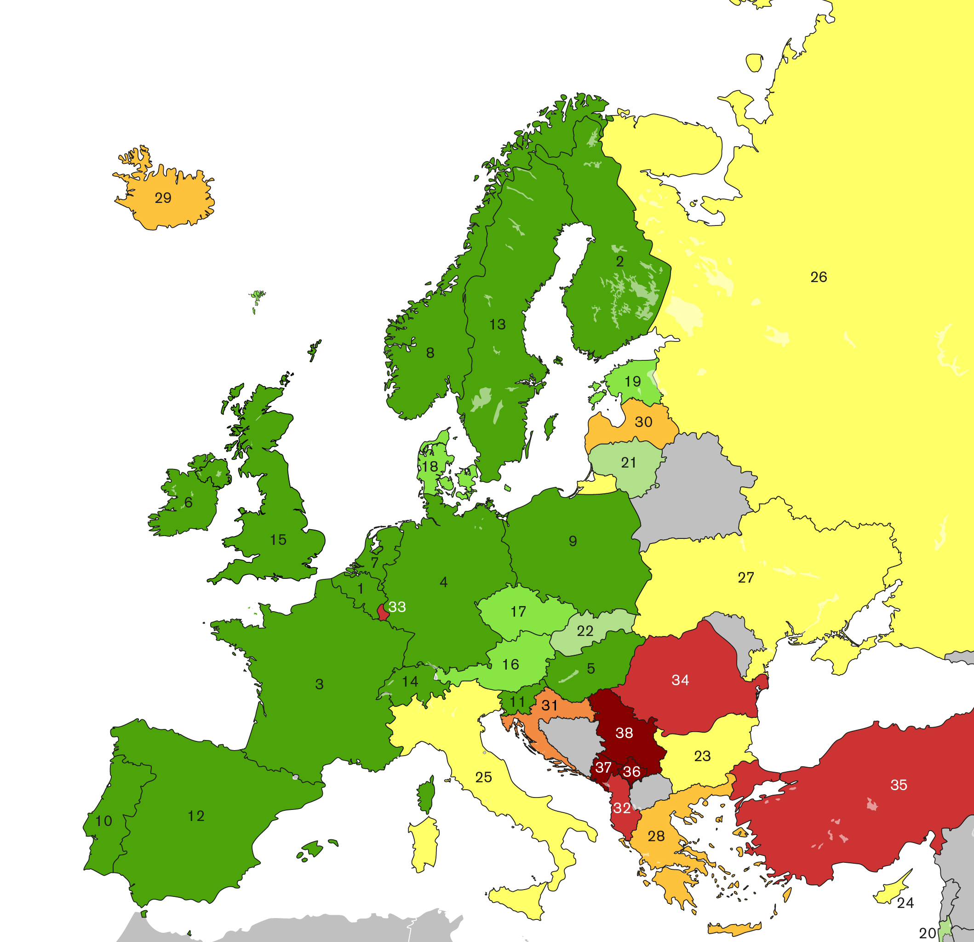
11
Participating countries
europeansocialsurvey.org

Slide 9
12
Questionnaire: Core and rotating modules
CORE
Media use; Internet use; social trust
Political interest, trust in others / institutions, electoral and other forms of participation, party allegiance, socio-political orientations, immigration
Subjective wellbeing, social exclusion, crime, religion, perceived discrimination, national and ethnic identity, vote intention in EU referendum
Socio-demographic profile
Human Values Scale
Rotating modules Two sections of approx. 30 questions on a single academic and/or policy concern within Europe
ROUND 10
2020-2021
Understandings and Evaluations of Democracy
Digital Social Contacts in Work and Family Life
COVID-19 Module
Questions developed by National Coordinators, CST and
international teams:
Government authority and legitimacy in the age of a pandemic
COVID-19 conspiracy beliefs and government rule compliance
europeansocialsurvey.org

Slide 10
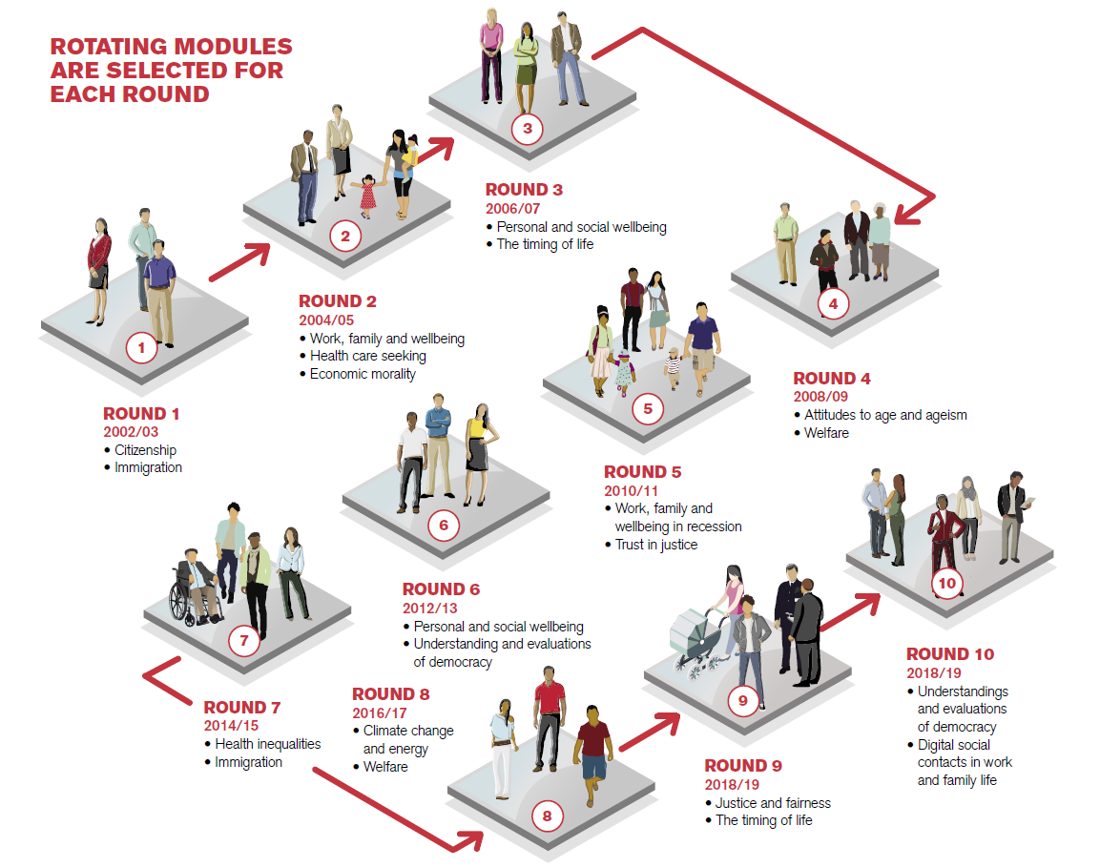
13

Slide 11
Expected results & Research Project Impact
Impact
ESS is highly regarded amongst international values and attitudes surveys, offering extremely high-quality data that is a critical resource for:
Academia
researchers across the social sciences.
Public Policy
International organisations such as Eurofound, United Nations Economic Commission for Europe (UNECE), European Commission’s DG EMPL (Employment, Social Affairs and Inclusion), OECD.
Think tanks including the Centre for European Policy Studies and European Policy Centre.
Governments and their agencies.
Education
Teaching courses, particularly within materials developed for use by students who are learning about survey methodology and quantitative data analysis.
The wider public
The results are expected to:
Document the changes in Greek society to the highest scientific standards. The benefits of documentation are manifold in terms of comparability with other countries before and during the crisis. The fact that Greece's participation stopped in 2011 created a knowledge gap especially with regard to the rotating modules which included key issues for the country such as migration and health inequalities .
Contribute to the comparative pan-European documentation of changing attitudes and behaviours in Europe.
Provide high quality evidence to researchers, academics, and policy makers in Greece addressing key social issues such as the economic crisis, migration, inequalities, trust in politics and political institutions, attitudes to climate change and the current COVID-19 pandemic.
Promote student’s analytical skills.

Slide 12
The importance of this funding
This funding enables Greece to reconnect with the most prestigious research infrastracture in the field of social sciences today and the broader developments in the European Research Area and the European Strategic Forum for Research Infrastructures (ESFRI).
Strengthens the national research infrastuctures in Greece indicating the ESS as an essential tool for the formulation of the national strategic roadmap for research, technology and innovation.
The project will advance the expertise and scientific excellence aquired by EKKE through its participation in previous rounds of the survey and in the refinement of rigorous methodological tools.
Greek data will chart stability and change in Greek society reaching out to a global audience of researchers, academics, policy-makers, journalists, students and the wider public.

Slide 14
COMMUNICATION
185 Syggrou Ave. & 2 Sardeon St. 2
171 21, N. Smyrni, Greece
+30 210 64 12 410, 420
info@elidek.gr
www.elidek.gr
23.07.2019

